Slide 1
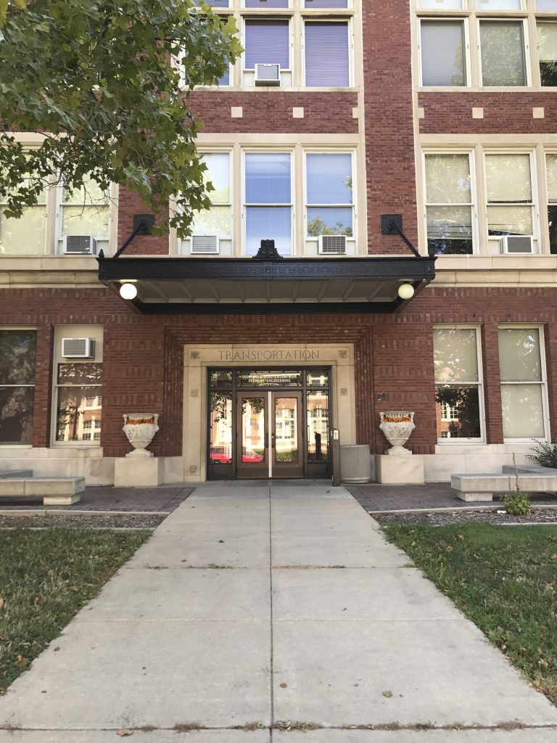

Network Analysis: Covid-19 Patients-Hospital Assignment Problem
Chang Sun, Rui Huang
IE 532: Network Analysis
Prof. Chrysafis Vogiatzis
Department of ISE, University of Illinois at Urbana-Champaign

Slide 2
Agenda
Introduction
Data
Algorithm
Q & A

Slide 3
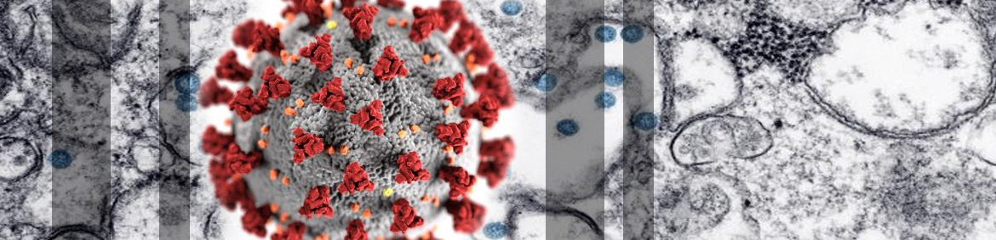
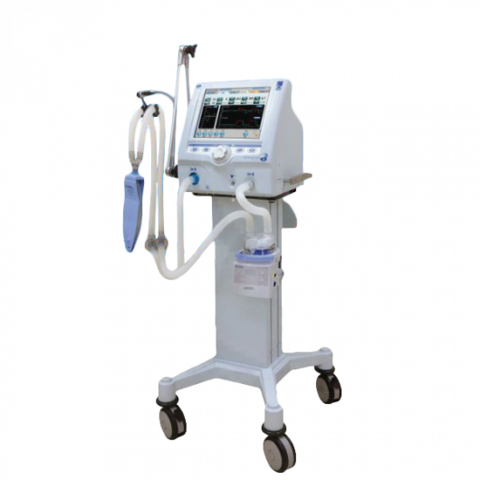


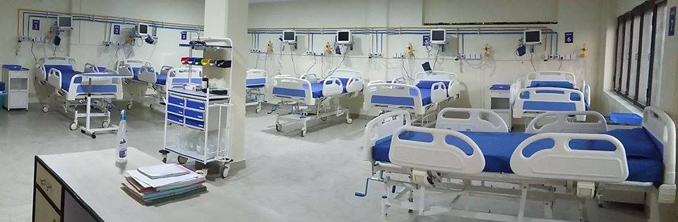
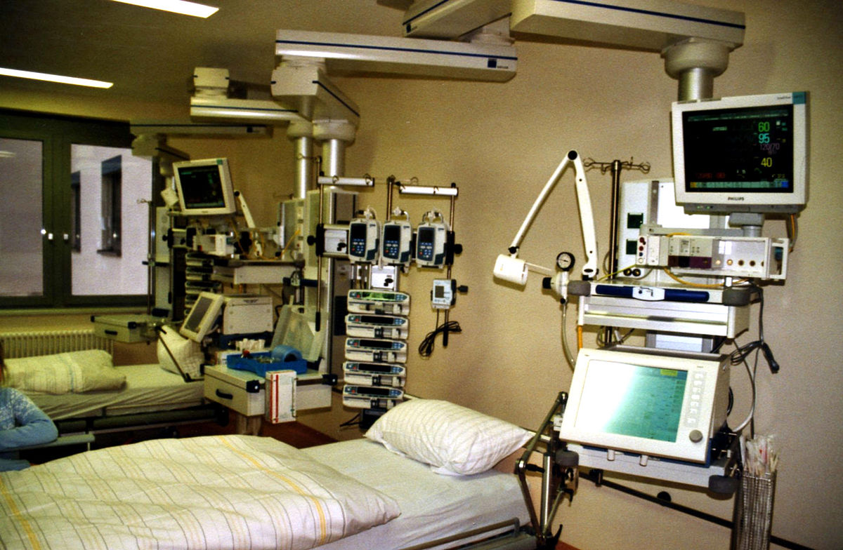
Introduction
Source: https://www.nh.gov/covid19/
This Photo by Unknown Author is licensed under CC BY
This Photo by Unknown Author is licensed under CC BY-SA
This Photo by Unknown Author is licensed under CC BY-NC

Slide 4
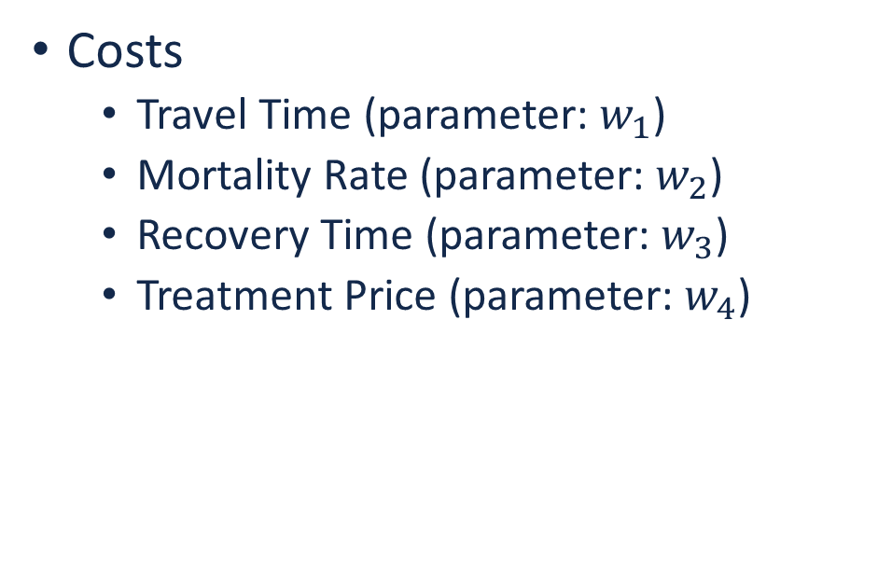
Data
Costs
Travel Time (parameter: $w_{1}$)
Mortality Rate (parameter: $w_{2}$)
Recovery Time (parameter: $w_{3}$)
Treatment Price (parameter: $w_{4}$)
Upper bounds
# of Non-ICU Beds
# of ICU Beds
# of ICU Beds with ventilator

Slide 5
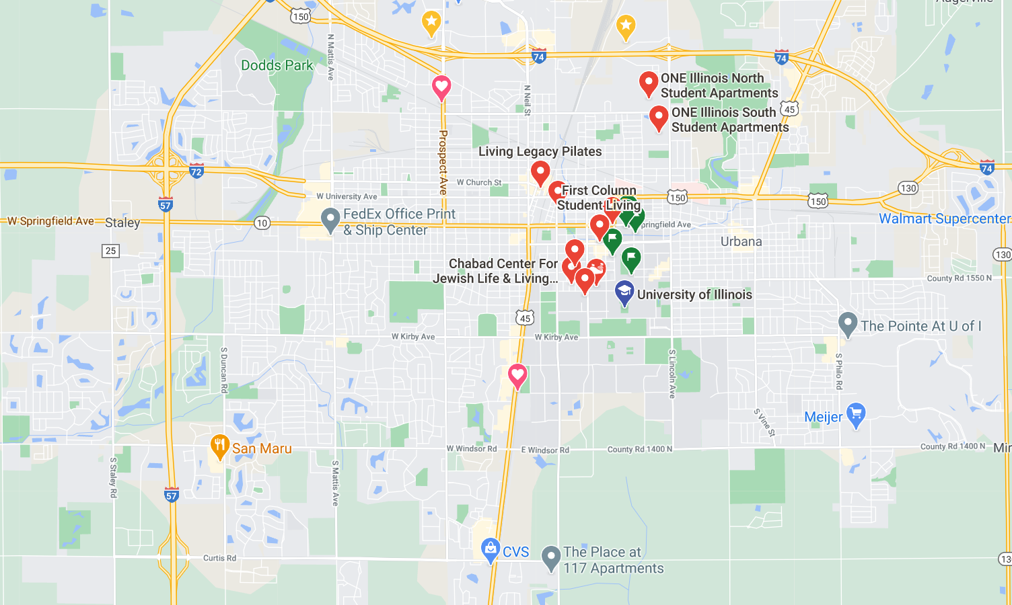
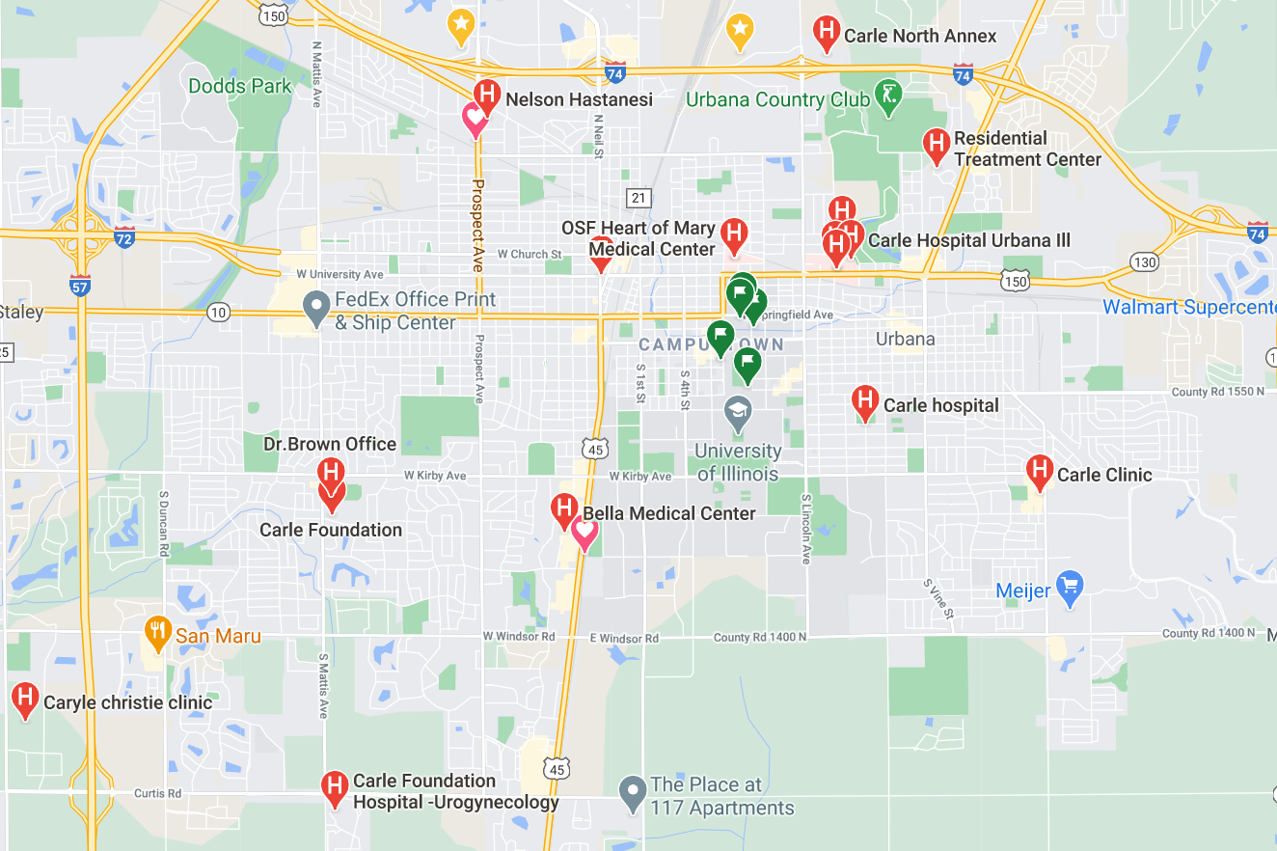
Data
Travel time

Slide 6
Data
Mortality Rate
Age Group (without treatment; only with self quarantine)
0-29, 30-64, 65+ years old
Discount of Mortality Rate
Treatment: Non-ICU beds, ICU beds, ICU beds with ventilator
Discounted Mortality Rate
Mortality Rate * Discount of Mortality Rate

Slide 7
Data
Recovery Time (time needed for patients to death or recovery)
Age Group (without treatment; only with self quarantine)
0-29, 30-64, 65+ years old
Discount of Recovery Time
Treatment: Non-ICU beds, ICU beds, ICU beds with ventilator
Discounted Recovery Time
Recovery Time * Discount of Recovery Time

Slide 8
Data
Treatment Price
Treatment: Non-ICU beds, ICU beds, ICU beds with ventilator

Slide 9
Minimum Cost Flow Problem
Minimum Cost Flow Problem
Directed Network
Each edge has a cost and a capacity
Each Vertex has a supply or demand
Find best way to send flow from supply vertices to demand vertices
This can be solved using Network Simplex Algorithm!
Notes:
the covid-19 patients-hospitals assignment problem is exactly a min cost flow problem

Slide 10
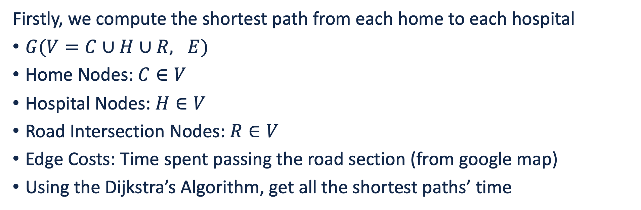
Shortest Path
Firstly, we compute the shortest path from each home to each hospital
$G(V=C∪H∪R, E)$
Home Nodes: $C∈V$
Hospital Nodes: $H∈V$
Road Intersection Nodes: $R∈V$
Edge Costs: Time spent passing the road section (from google map)
Using the Dijkstra’s Algorithm, get all the shortest paths’ time

Slide 11
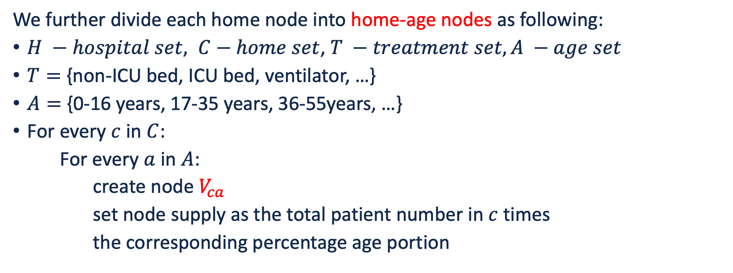
Patient-Hospital Graph Nodes
We further divide each home node into home-age nodes as following:
$H −hospital set, C−home set$, $T −treatment set, A −age set$
$T=$ {non-ICU bed, ICU bed, ventilator, …}
$A=$ {0-16 years, 17-35 years, 36-55years, …}
For every $c$ in $C$:
For every $a$ in $A$:
create node $V_{ca}$
set node supply as the total patient number in $c$ times
the corresponding percentage age portion

Slide 12
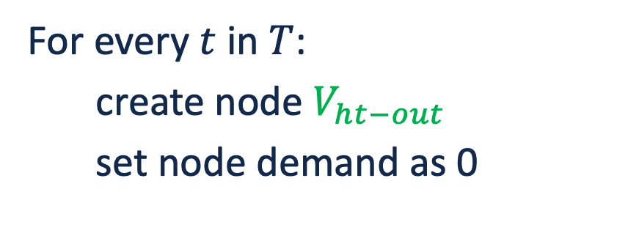
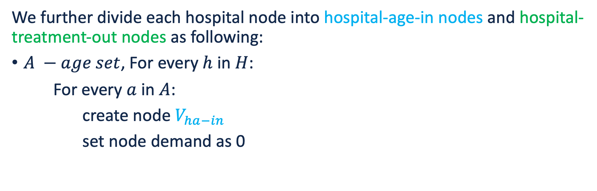
Patient-Hospital Graph Nodes
We further divide each hospital node into hospital-age-in nodes and hospital-treatment-out nodes as following:
$A −age set$, For every $h$ in $H$:
For every $a$ in $A$:
create node $V_{ha−in}$
set node demand as 0
For every $t$ in $T$:
create node $V_{ht−out}$
set node demand as 0
Also create a terminal node , and set demand equal to the num of total patients

Slide 13
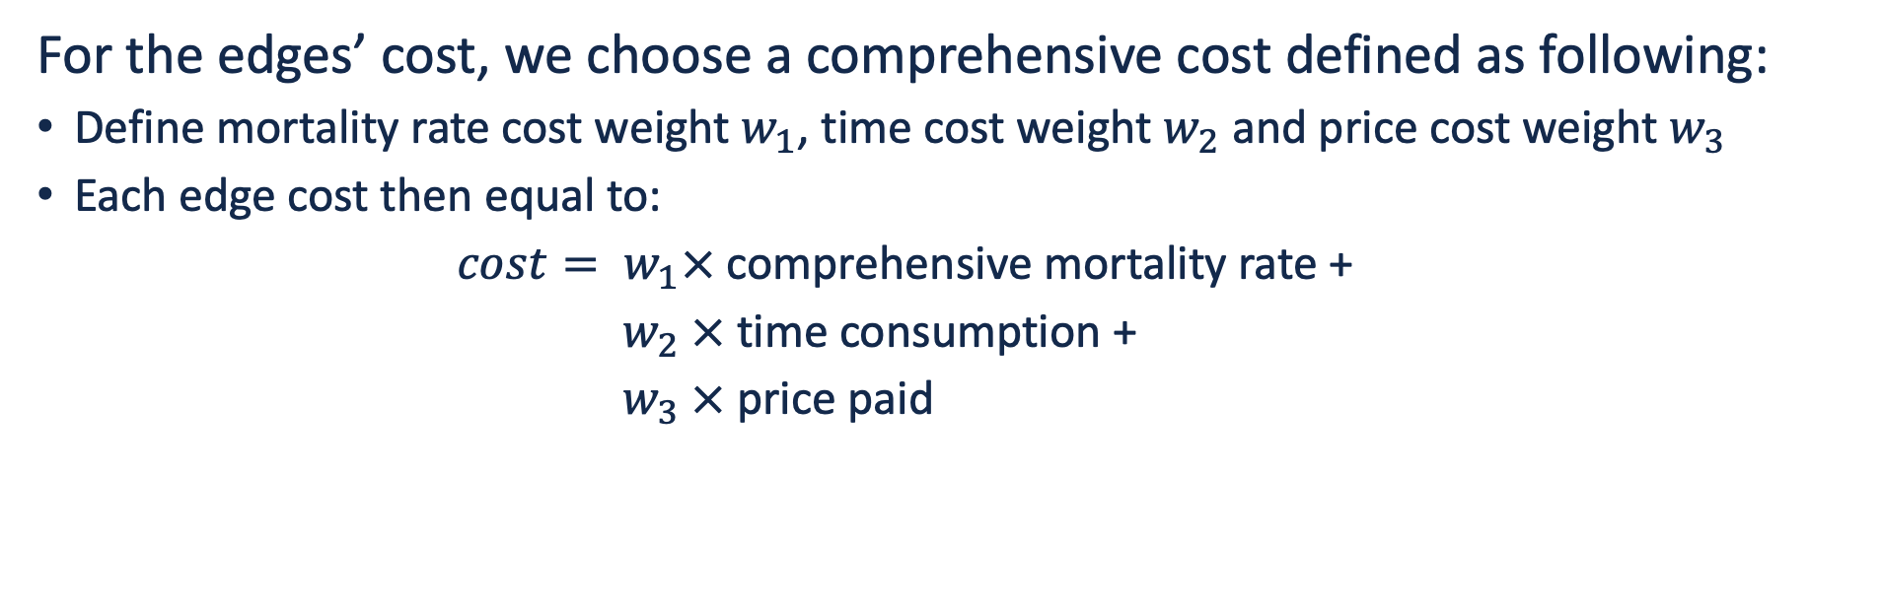
Patient-Hospital Graph Edges
For the edges’ cost, we choose a comprehensive cost defined as following:
Define mortality rate cost weight $w_{1}$, time cost weight $w_{2}$ and price cost weight $w_{3}$
Each edge cost then equal to:
$cost= w_{1}×$comprehensive mortality rate +
$w_{2} ×$time consumption +
$w_{3} ×$price paid

Slide 14
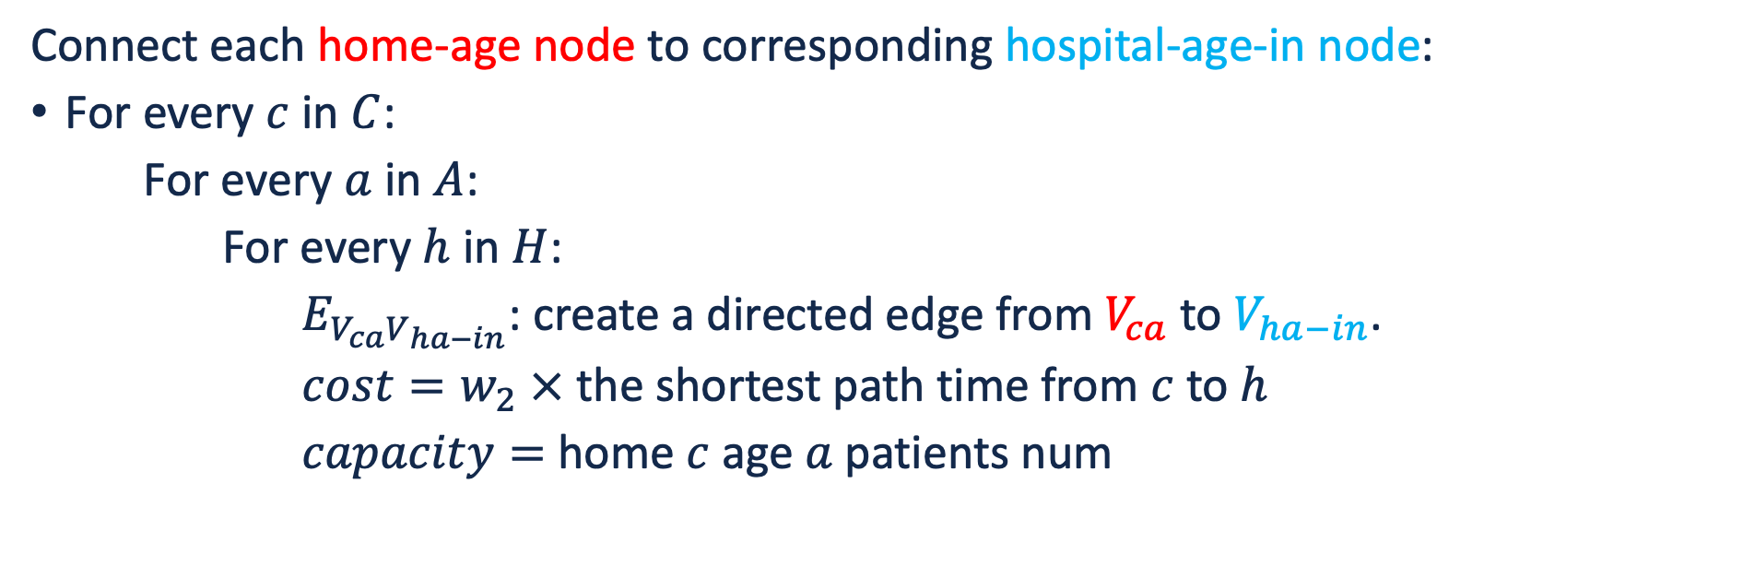
Patient-Hospital Graph Edges
Connect each home-age node to corresponding hospital-age-in node:
For every $c$ in $C$:
For every $a$ in $A$:
For every $h$ in $H$:
$E_{V_{ca}V_{ha−in}}$: create a directed edge from $V_{ca}$ to $V_{ha−in}$.
$cost=w_{2} ×$the shortest path time from $c$ to $h$
$capacity=$ home $c$age $a$patients num

Slide 15
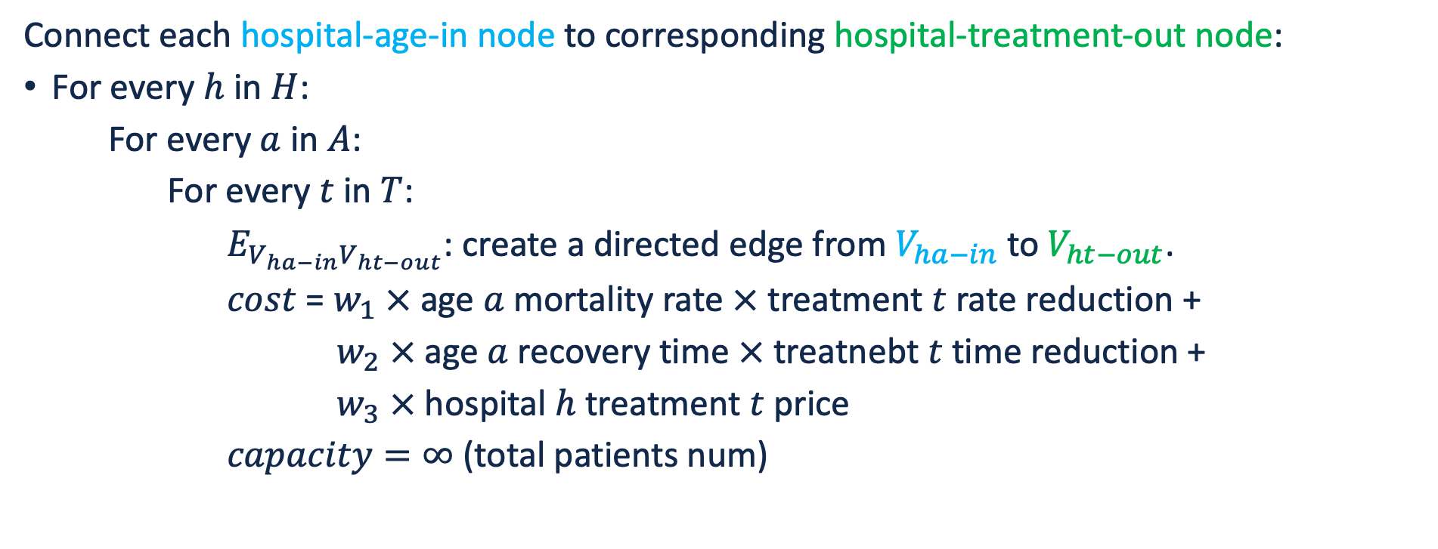
Patient-Hospital Graph Edges
Connect each hospital-age-in node to corresponding hospital-treatment-out node:
For every $h$ in $H$:
For every $a$ in $A$:
For every $t$ in $T$:
$E_{V_{ha−in}V_{ht−out}}$: create a directed edge from $V_{ha−in}$to $V_{ht−out}$.
$cost$ = $w_{1} ×$age $a$mortality rate $×$ treatment $t$rate reduction +
$w_{2} ×$age $a$recovery time $×$ treatnebt $t$ time reduction +
$w_{3} ×$ hospital $h$treatment $t$ price
$capacity=∞$ (total patients num)

Slide 16
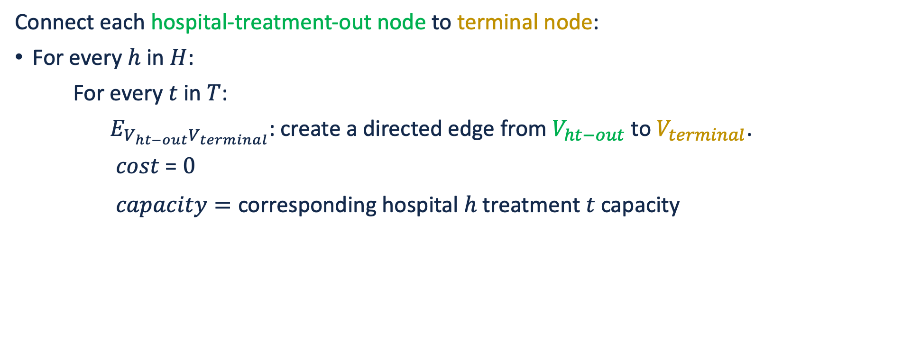
Patient-Hospital Graph Edges
Connect each hospital-treatment-out node to terminal node:
For every $h$ in $H$:
For every $t$ in $T$:
$E_{V_{ht−out}V_{terminal}}$: create a directed edge from $V_{ht−out}$to $V_{terminal}$.
$cost$ = $0$
$capacity=$ corresponding hospital $h$treatment $t$ capacity

Slide 17
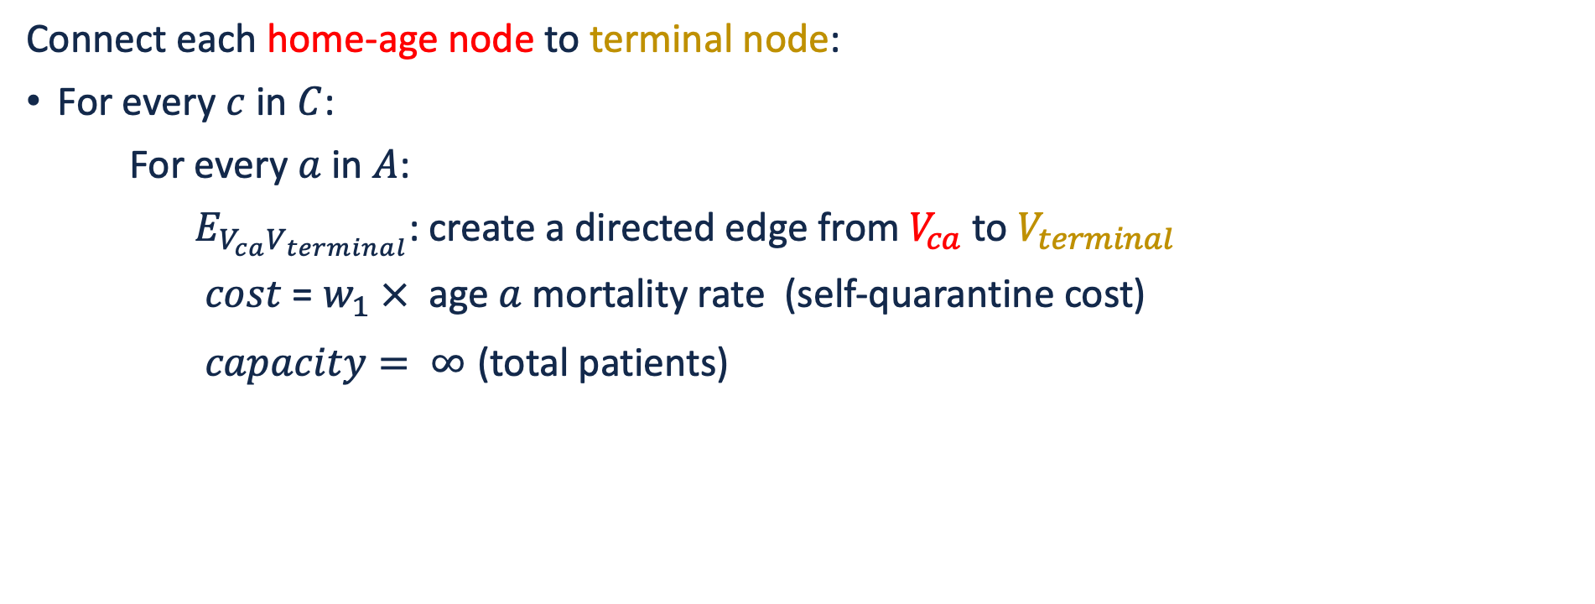
Patient-Hospital Graph Edges
Connect each home-age node to terminal node:
For every $c$ in $C$:
For every $a$ in $A$:
$E_{V_{ca}V_{terminal}}$: create a directed edge from $V_{ca}$to $V_{terminal}$
$cost$ = $w_{1} ×$ age $a$ mortality rate (self-quarantine cost)
$capacity= ∞$ (total patients)

Slide 18
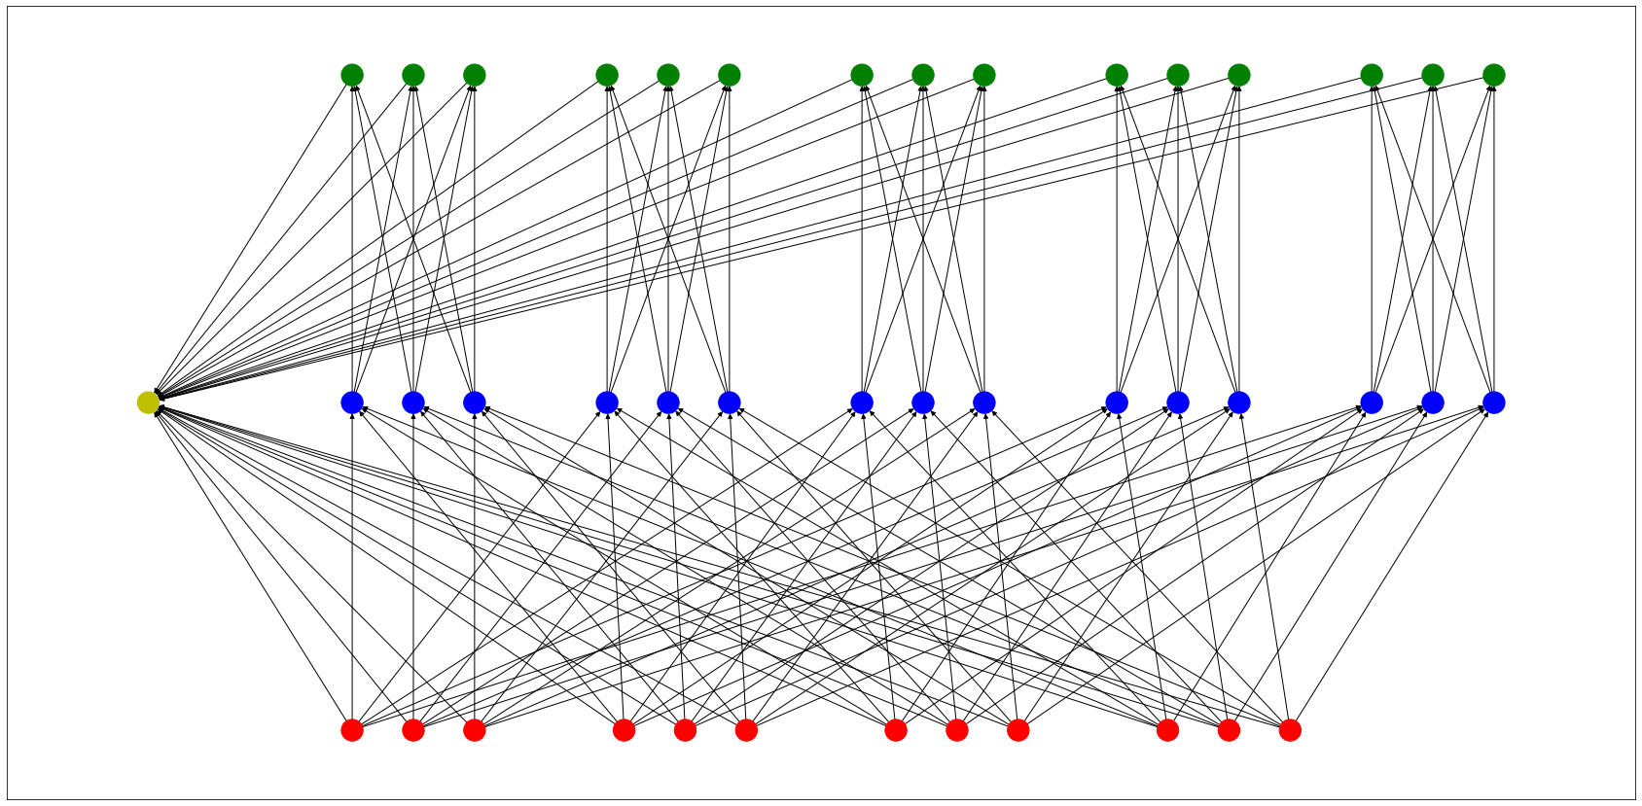
Patient-Hospital Graph
Hospital-treatment-out nodes
Terminal
Hospital-age-in nodes
Home-age nodes

Slide 19
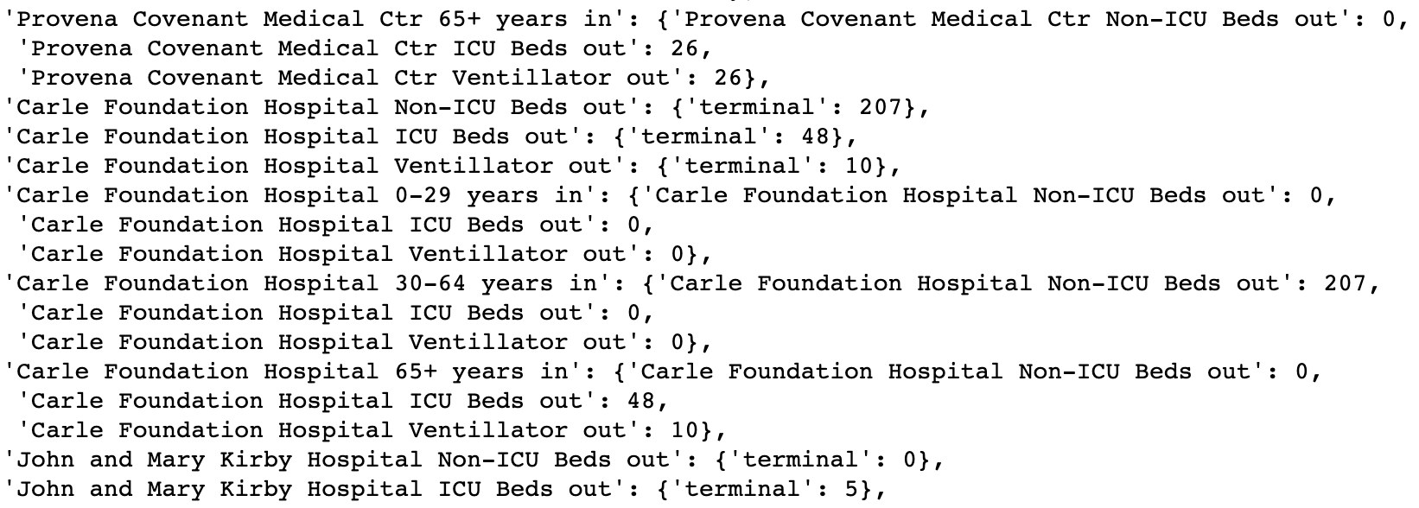
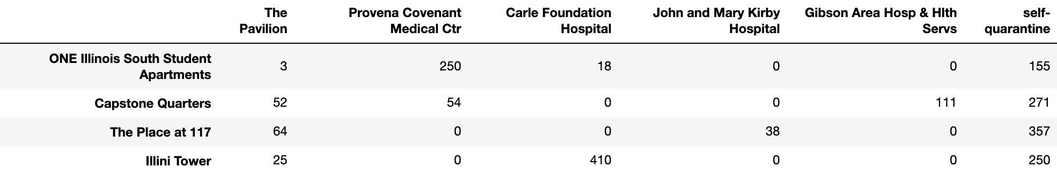
Patient-Hospital Assignment
Using network simplex method solve this min cost flow problem
networkx.min_cost_flow(G, demand='demand', capacity='capacity', weight='weight’)

Slide 20
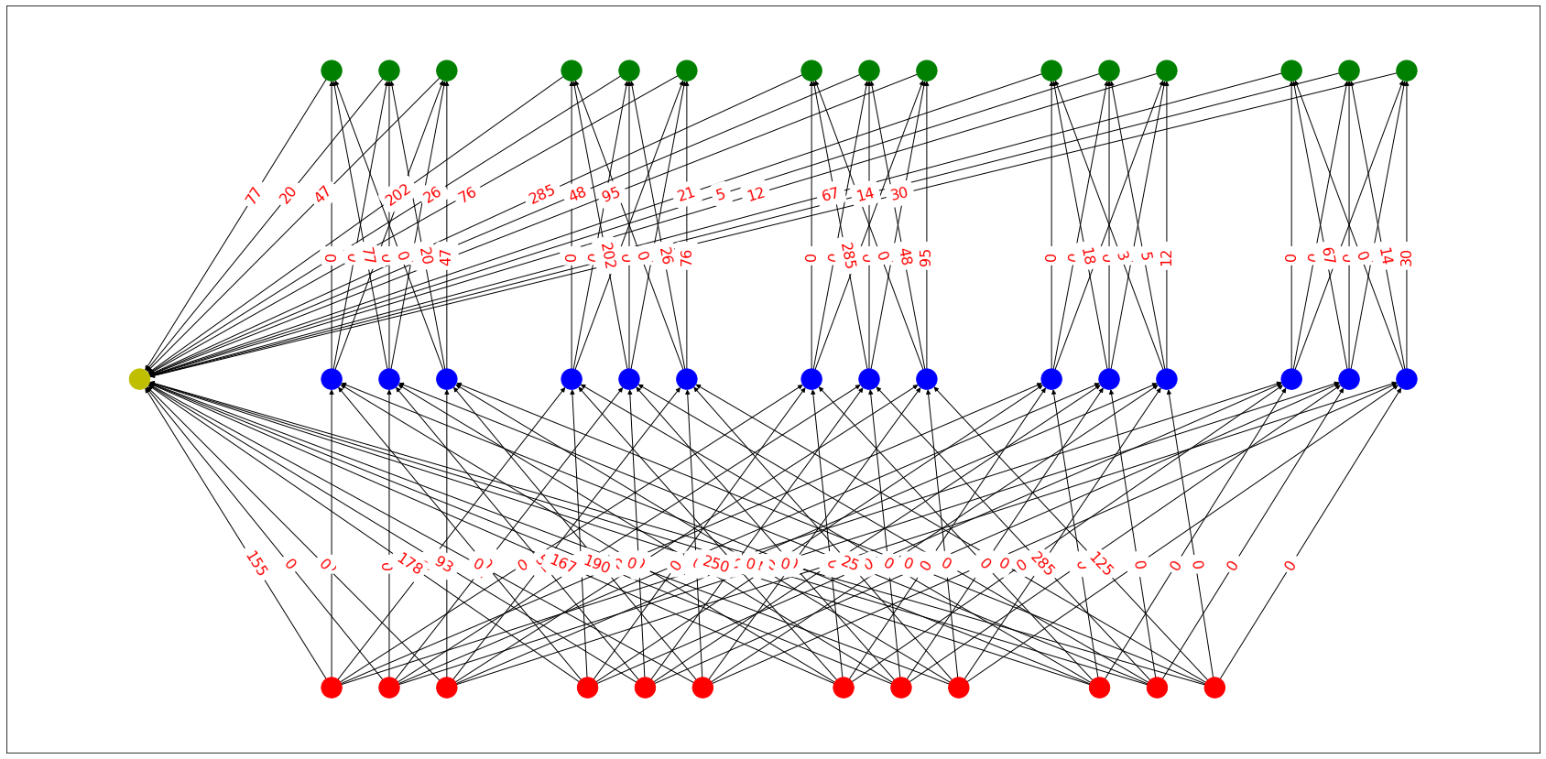
Patient-Hospital Flow

Slide 21
Q & A
Thank you!

